Slide 1
Financial Trends and Forecasts
A Data-Driven Prediction of the Future of Investment

Slide 2

Introduction: The Crystal Ball of Finance
Can we predict the future of investment?
By analyzing current trends and investor behavior, we can gain valuable insights into what lies ahead.

Slide 3
Data Deep Dive: Understanding the Present
Let's first understand the current landscape of investment choices. We'll examine key demographics and preferences.

Slide 4
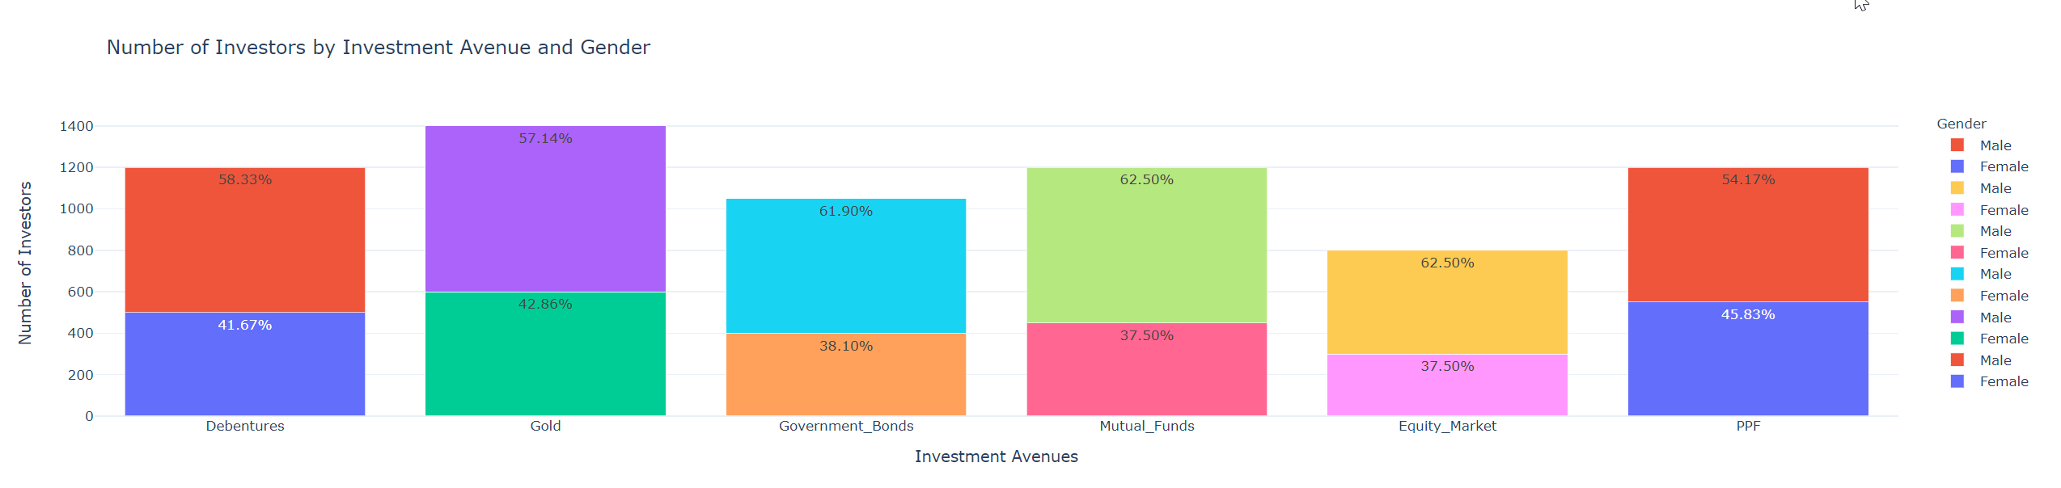
Trend Identification: Unveiling the Patterns
What are the emerging trends?
Are certain investment avenues gaining or losing popularity?

Slide 5
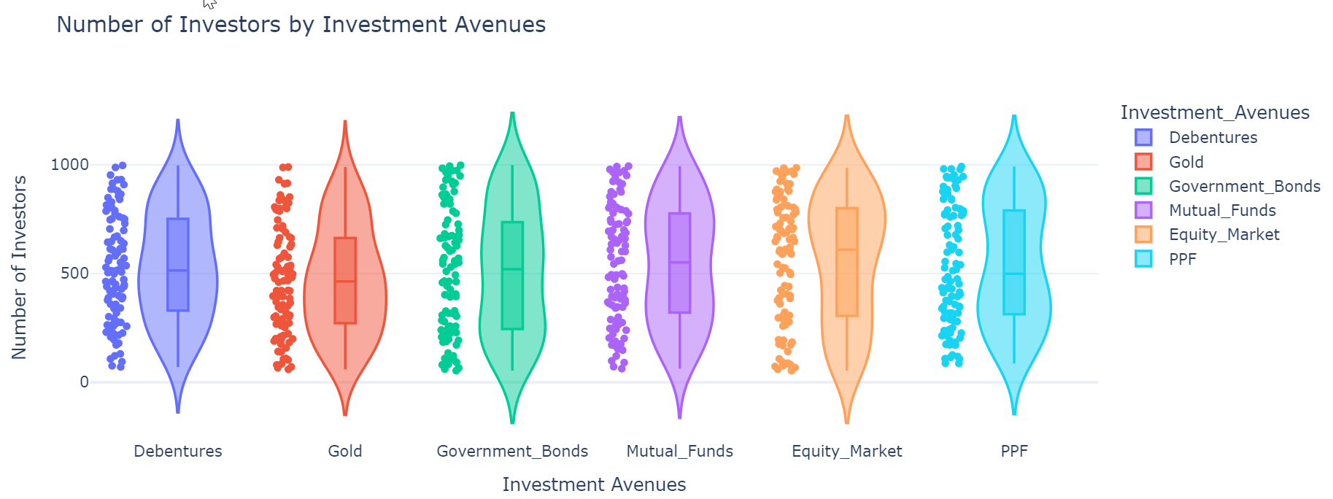
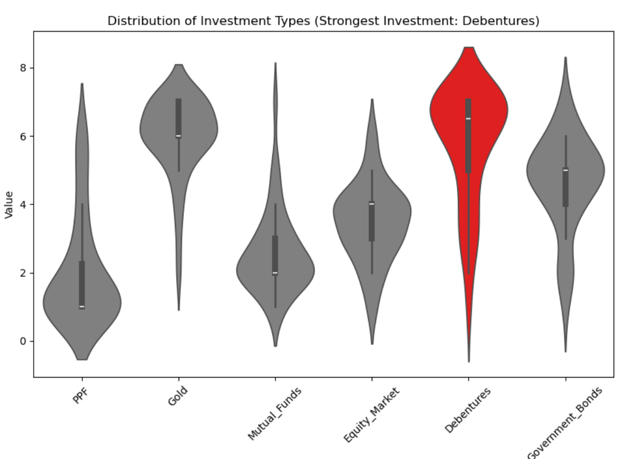
Factor Analysis: What Drives Investment Decisions?
Which factors have the strongest influence on investment decisions?
-We'll explore the key drivers.

Slide 6
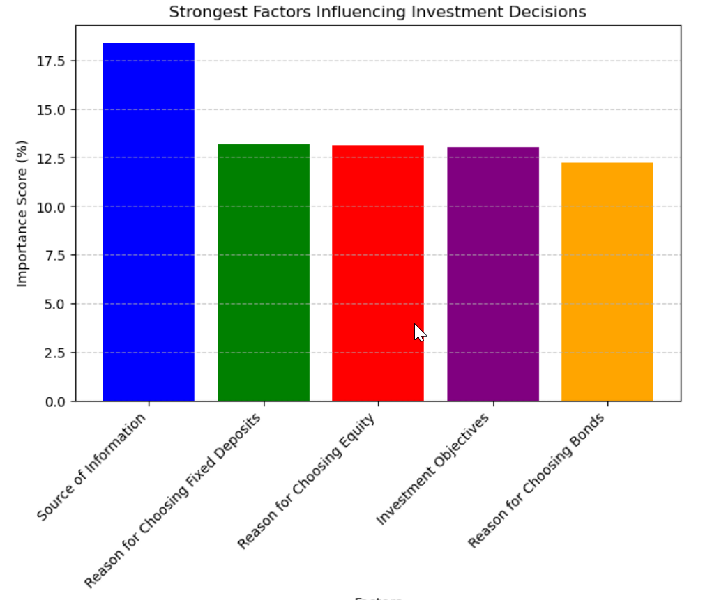
Factor Analysis: What Drives Investment Decisions?
Strongest Factors Influencing Investment Decisions:
Source of Financial Information (18.4%)
2. Reason for Choosing Fixed Deposits (13.2%)
3. Reason for Choosing Equity (13.1%)
4. Investment Objectives (13.0%)
5. Reason for Choosing Bonds (12.2%)

Slide 7
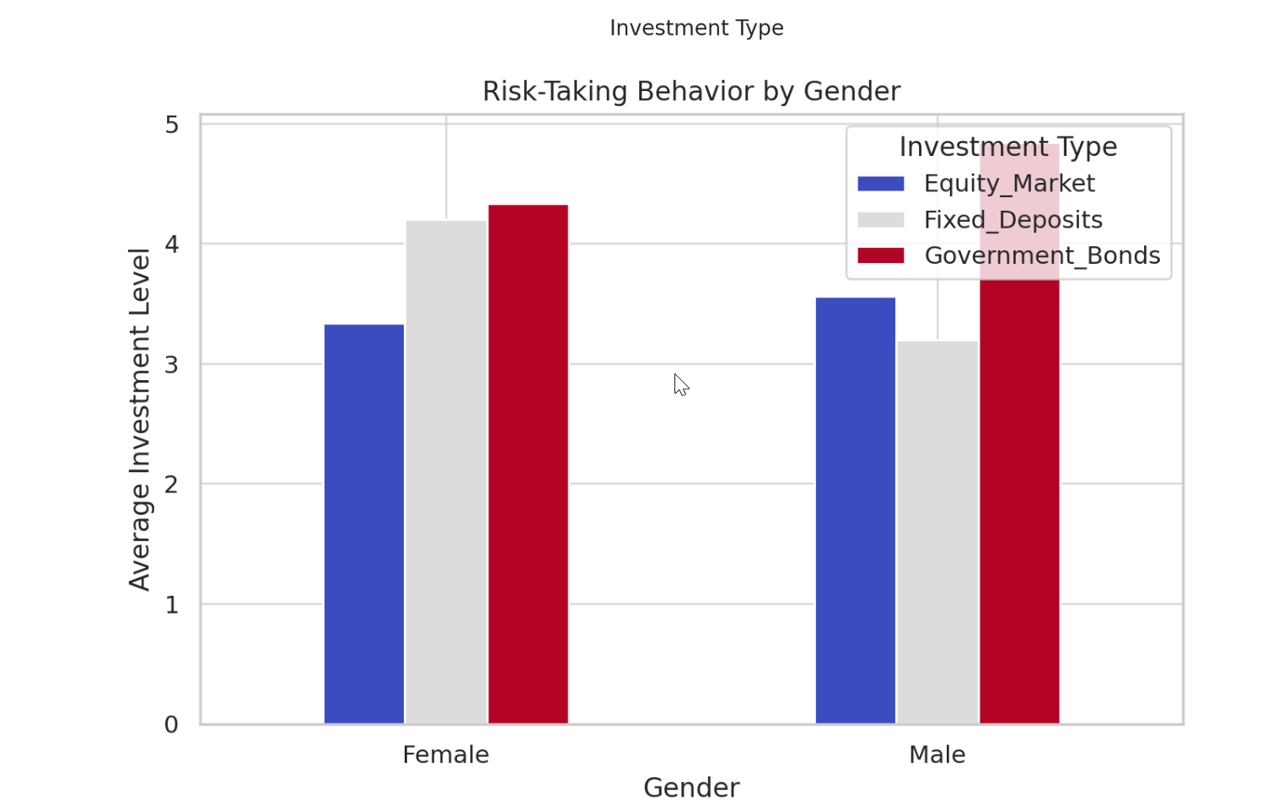
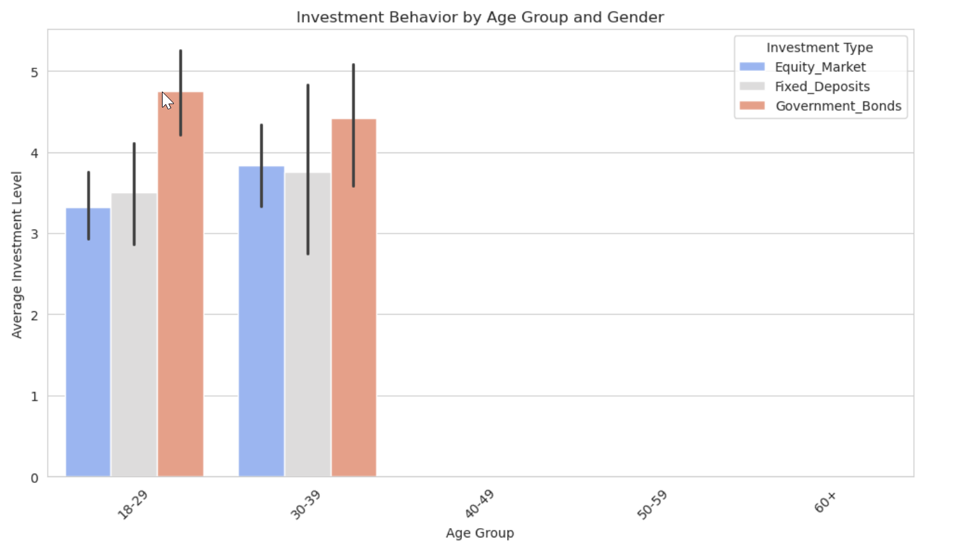
Factor Analysis – Risk Taking Behavior
It is very possible that gender and age interact with each other in regards to risk taking behavior. Meaning that risk taking behavior in males, may change across age groups differently than risk taking behavior in females.

Slide 8
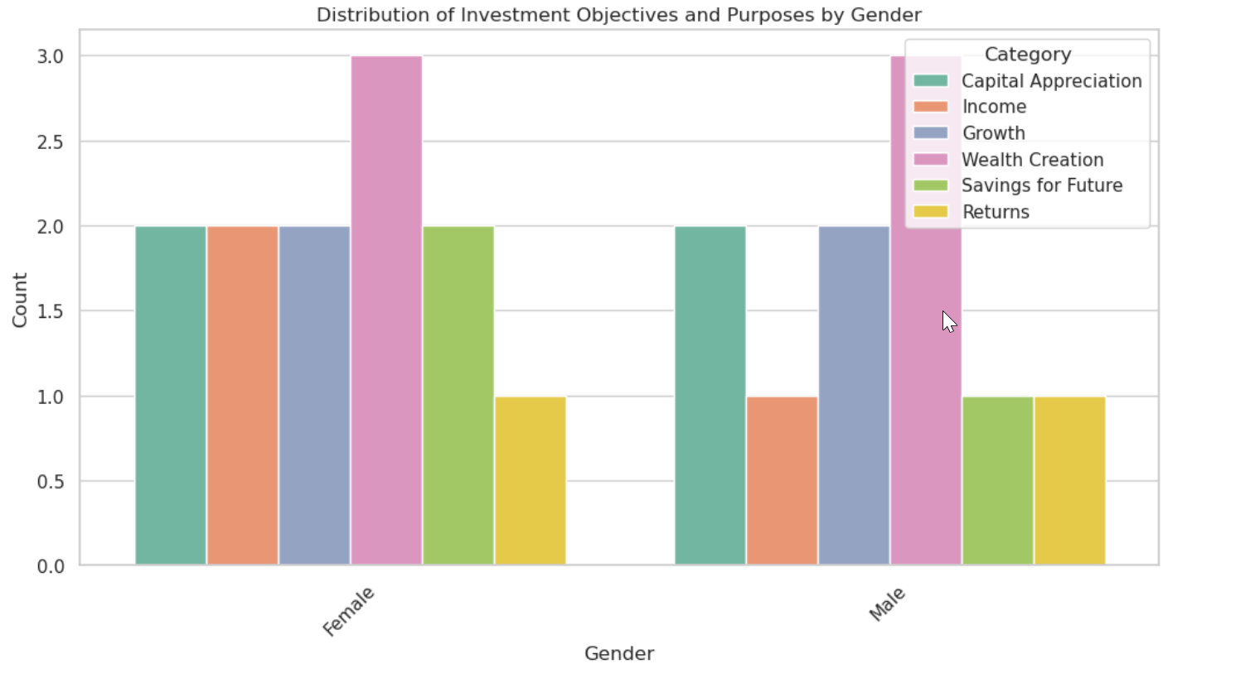
Objective and Purpose of Investment
Investment Objectives and Purposes

Slide 9
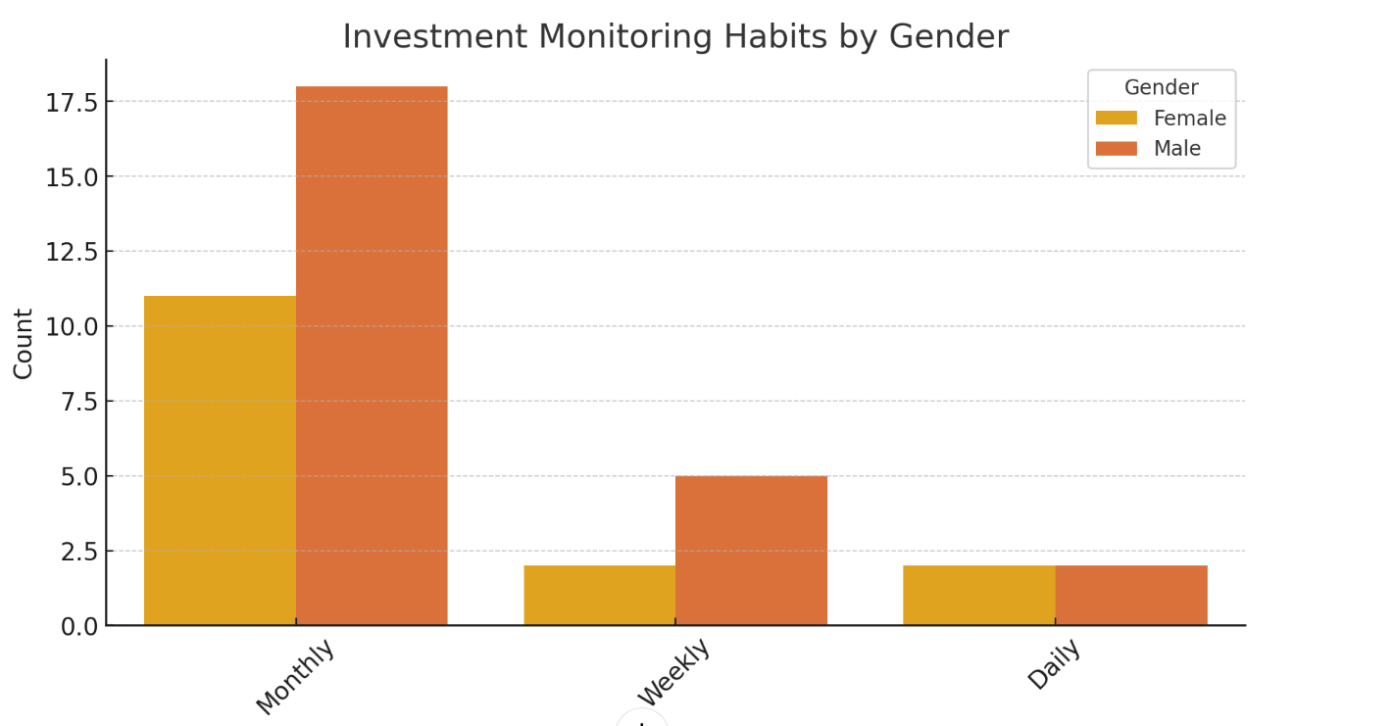
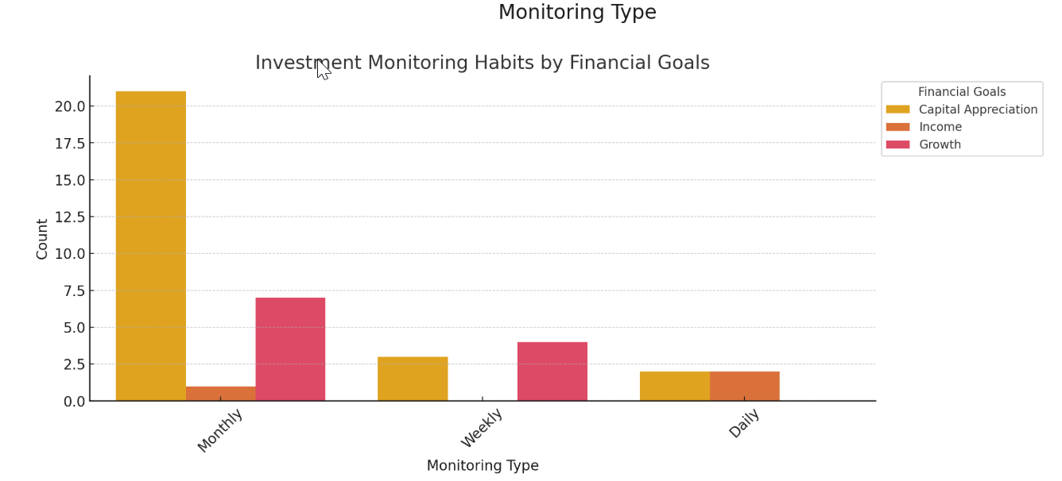
Forecasting - Predicting Future Investment Trends
Investment Monitoring Habits by Gender
-Shows how different genders monitor their investments, with categories such as regular tracking, occasional tracking, or passive monitoring.
Investment Monitoring Habits by Financial Goals
-Highlights how individuals with different financial objectives (e.g., wealth creation, savings, retirement) prefer to monitor their investments.

Slide 10
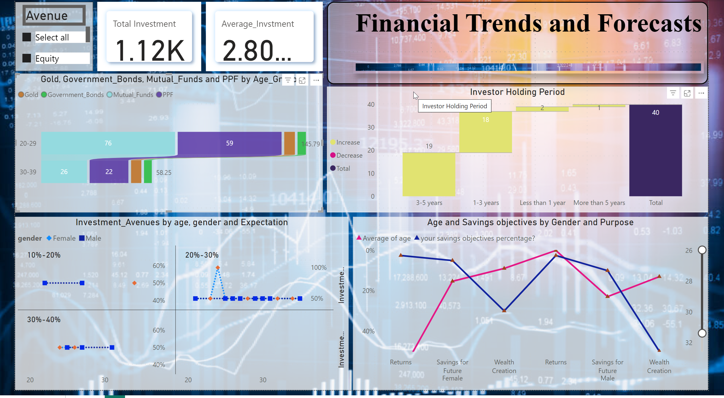
Power BI Report

Slide 11

Key Insights from the Data:
Gold & Debentures Lead Investments:
Gold and Debentures are the most preferred investment choices, significantly ahead of other assets.
Possible Insight: Investors might perceive these as safe yet lucrative options.
Risk-Taking Varies by Gender:
Males invest more in Equity Markets, indicating a higher risk appetite.
Females lean towards Government Bonds and Fixed Deposits, favoring stability.
Age Group Shifts in Investments:
Younger investors (20-30) show higher interest in Gold and PPF, possibly prioritizing long-term security.
Middle-aged investors (40-50) gradually shift towards Debentures and Fixed Deposits, suggesting a balanced risk approach.
Older investors lean towards Government Bonds for steady returns.

